Slide 1

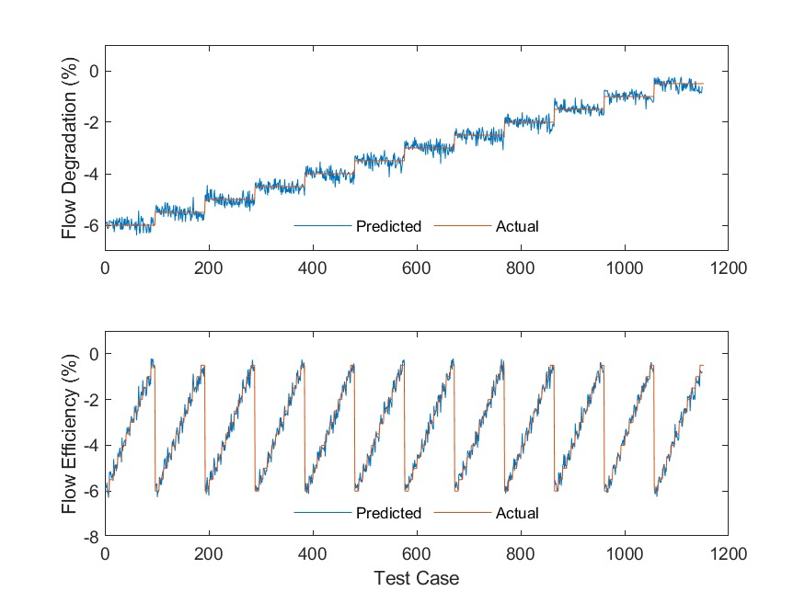
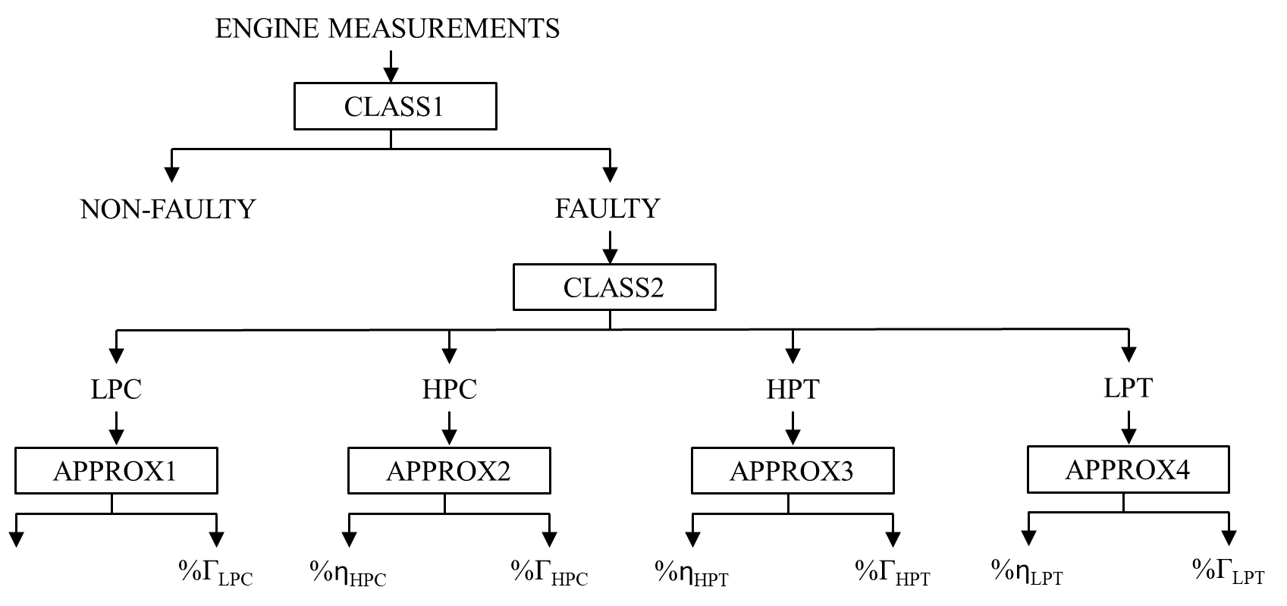
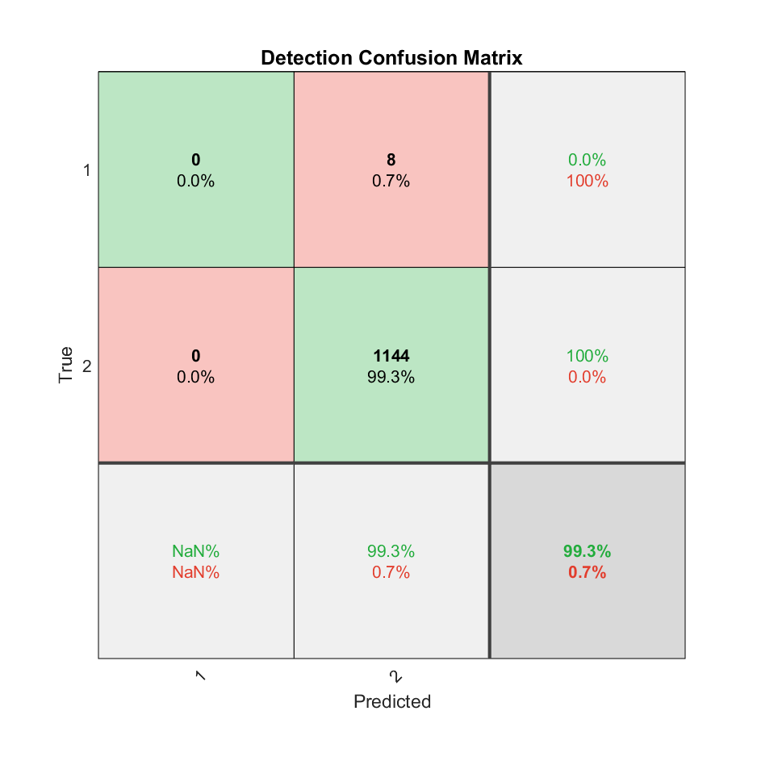
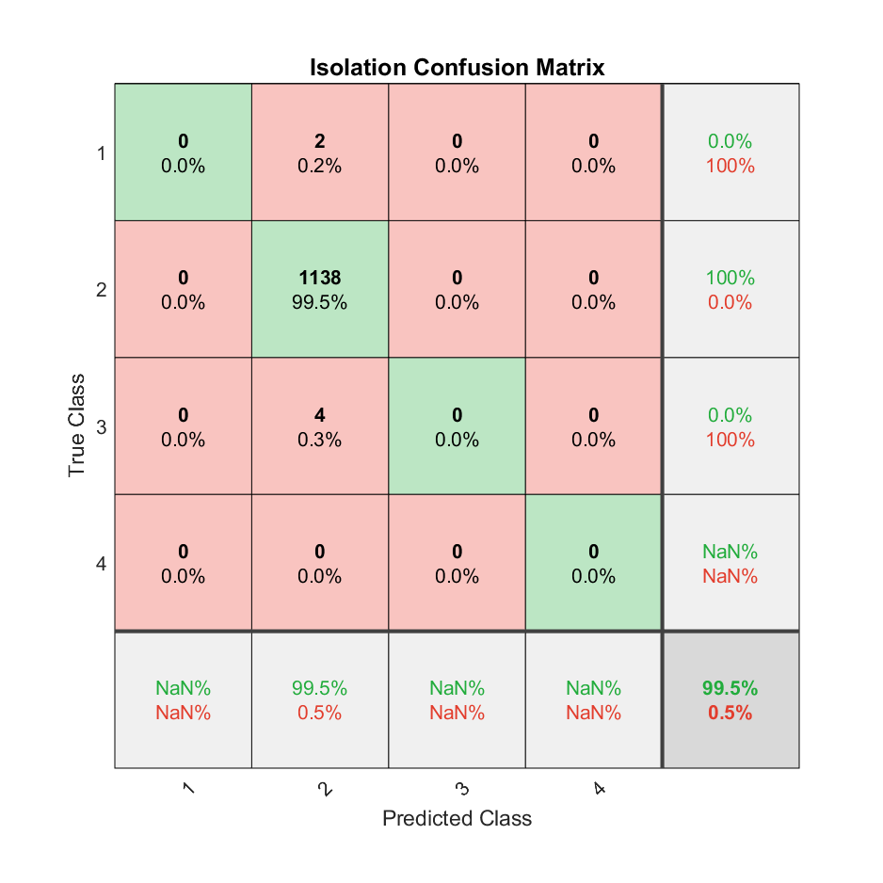

Aim and Objectives: ● Develop a digital engine model for the CFM56-5B4 engine. ● Validate the design point and off-design performance of the engine model. ● Generate sample data for training ANNs. ● Train and validate ANNs. ● Design and implement nested Neural Networks for single-component faults. ● Assess the trained ANNs’ performance. Methodology:
APPLICATION OF ARTIFICIAL NEURAL NETWORKS IN GAS PATH DIAGNOSTICS FOR TWO-SPOOL TURBOFAN ENGINES
Fahmi Septian
Supervisor: Dr. Yiguang Li
Results:
Conclusions: ● A MATLAB-based nested Neural Network was developed to detect, isolate, and quantify single-component faults in a turbofan engine.
● The performance of CLASS 1 and CLASS 2 networks exceeded 99% accuracy, while those of APPROX 1 to 4 achieved above 98% accuracy.
● The quantification performance of the networks was within an error margin of 0.1%.
Key references: [1] Adapted from S. Ogajiye, T.-O. Ogaji, and R. Singh, “Advanced Gas-path Fault Diagnostics for Stationary Gas Turbines,” 2002.
Figure 5 HPC’s efficiency degradation results
Figure 2 Nested Neural Networks for SCF [1]
Literature Review
Engine Data
Engine Specs
Engine Modeling
DP & OD Verification
NN Sample Generation
Figure 3 CLASS 1 and CLASS 2 confusion matrix
Detection NN Training
Isolation NN Training
Quant.
NN Training
Nested NN Creation
Figure 4 HPC’s flow capacity degradation results
Figure 1 Project methodology
Thermal Power MSc. March Cohort AYR23 (2023-2024)
13 February 2025

